Slide 1

Zambia’s Position
Presenter: Mr. Peter N Mumba

Slide 2
Debt Management in Zambia
Moratorium (suspension) on debt service payments from 2020 pending comprehensive debt restructuring.
International Monetary Fund Program: 36 months and at a value of US$1.4 billion
Debt Restructuring: Zambia hopes to restructure US$12.8 billion in order to improve its debt carrying capacity.
Public Debt Management Act – Promote Responsible Borrowing
Medium Term Debt Strategy
Annual Borrowing Plan
Debt Management Office
Sinking Fund
More transparency (Quarterly engagements with MoF, BoZ, GRZ)
Enhanced Accountability and transparency Oversight

Slide 3

Debt Restructuring – Under the G20 Common Framework
Managed to restructure US$ 6.3 Billion of Official Creditor (0CC) Debt.
A Memorandum of understanding between OCC and Creditors was finalized with China and India signing in March this year.
Managed to restructure in principle our US$ 3 billion Eurobond debt.
What remains is to restructure the remaining US$ 3 billion Private creditor debt.

Slide 4
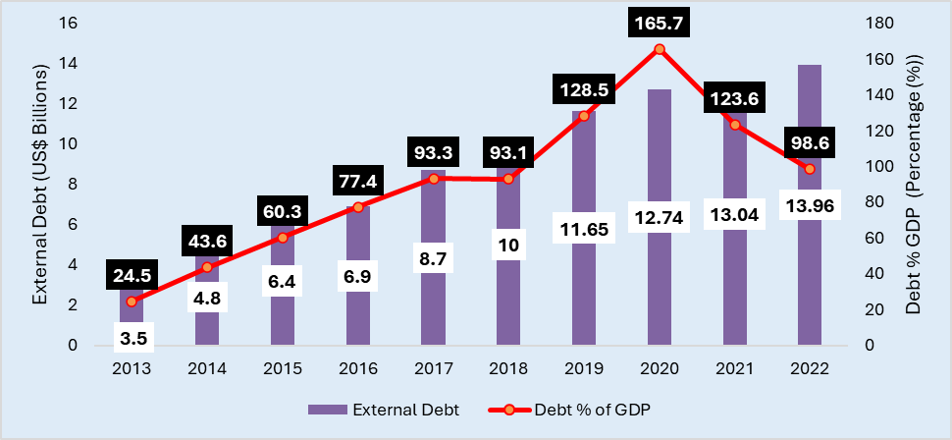
Movements in Public Debt

Slide 5
Zambia’s Current Debt Position
According to the Ministry of Finance and National Planning, Zambia’s total debt burden increased from US$19.8 billion in 2020 reaching US$22.7 billion at the end of 2021 and US$25 billion at end of 2023 as shown in the table
 | Type of Debt | Amount (US$ Millions)
Total Public Sector Debt |  | 25,033.34
 | Central Government External Debt | 14,572.92
 | Guaranteed State-Owned Enterprises external Debt | 1,407.14
 | Non-Guaranteed External Debt | Fully Re-paid
 | Central Government Domestic Debt | 9,053.28
 | Private Sector External Debt | 8,023.60
 | Total External Arrears | 6,379.87
 | Total Domestic Arrears | 3,704.43

Slide 6
Debt Restructuring – Under the G20 Common Framework
Significant maturity extensions of our existing debt by more than twelve years with final maturity in the year 2043.
Principle repayments are starting in 2026, three years from now, however, only for 0.5 per cent of the debt stock per annum for the period 2026 to 2035
Zambia was supposed to pay US$6.3 billion over the period. With agreement over the next ten years, US$ 750 million will be paid while without the agreement, we would have had to pay a US$6.3 billion.
It generates US$5.8 billion in debt services saving which unlock resources that can be utilized for our developmental programmes.

Slide 7
Debt Restructuring – Under the G20 Common Framework
Some risks include:
Resumption of debt servicing (E.g US$75 million down payment on the date of exchange of bonds; US$187 million in June 2024 & US$79 million in December 2024).
El Nino – This has created a financing gap of about US$ 900 million. Hence, the budget needs revision & It has also contributed to a 700-mega watt power deficit in the country. (Risks around copper production, SME’s and Food security).
Depreciating Kwacha & Inflation – BoZ Continues to embark on a tight monetary policy stance (Under performance of Bonds and Treasury Bills Offer – Risk to budget financing).
Rigidities in the caused by the country’s IMF programs – E.g. inflexible inflation target, reserves, austerity measure (subsidies & cost reflective energy tarrifs).

Slide 8
Debt Restructuring – Under the G20 Common Framework
What to look out for:
June debt service payment
Revised budget – Gender responsive interventions
June meeting for Eurobond Holders – To vote on the restructuring proposal.
Investments/ performance in the mining sector – key for revenues
Protection of SME’s
Monitoring of IMF program reforms

Slide 9
Major take aways from the IMF Program
Enhance Domestic Resource Mobilisation – Various Tax Reforms
Fiscal Consolidation
Pursues contractionary Fiscal Policy - The size of the Budget is planned to contract to 33 percent in 2025 from 37 percent in 2022.
Pursues contractionary monetary policy - The IMF Programme obsesses with price stability by keeping inflation between 6-8%.
Push towards cost reflective energy tariffs - Tariffs to rise by an average of 17 percent between 2020 and 2025 (E.g Fuel Pump prices).
Enhanced Social Sector Spending
Restoring Debt Sustainability

Slide 10
Advocacy for Transparency and Accountability
PUBLIC INTEREST (Public Debt Management Act, the Public Finance Management Act, the Auditor General’s Report on Public Debt), Adherence to Annual Borrowing Plans (Auditing).
Adherence to Medium Debt Management Strategy (No non concessional debt)
Establishment of the Debt Management Office
Operationalisation of the Sinking Fund
Transparency on Loan Conditions and Terms (Drought financing)

Slide 11
Thank You!

