Slide 1
Prospects and Challenges of Restructuring Zambia’s Debt
Caesar Cheelo
Research Fellow
Southern African Institute for policy and research
Public forum Prospects of Restructuring Zambia’s Debt
31st March 2023 18:00-20:30
Taj Pamodzi Hotel

Slide 2
Outline
  Economic History of Zambia’s Debt
  Debt Restructuring Negotiations

Slide 3
1. Economic History of Zambia’s Debt
Zambia’s Long-term economic (GDP) growth perspective shows Roughly Three episodes of
1960-1998: a period of 38 years with unstable and declining real GDP growth (1st wave of debt accumulation).
1998-2010: an 11-year period of Sustained increase in real GDP growth (with debt correction in 1990’s & early 2000’s) .
2011-2021: a 10-year period of steady real GDP growth decline/slowdown; turned negative with COVID-19.... (2nd wave of debt accumulation)

Slide 4
1. Economic History of Zambia’s Debt (cont’d)
Picking up the debt story in 1990…
Total public debt stock was once 245% of GDP (1998); now 119% of GDP (2021)
when UNIP handed over to MMD, per capita GDP was $427 while per capita public debt was $760;
when MMD handed over to PF, they had fixed things; per capita GDP was at $1,644 & per capita public debt at $342;
By the time PF handed over to UPND in 2021, they had messed things up badly; per capita GDP down to $1,137 & per capita public debt up, at $1,355;
UPND is expected to fix the mess within 5 years; it took MMD 14 years to fix a relatively smaller problem... What are the implications of electoral pressure?

Slide 5
1. Economic History of Zambia’s Debt (cont’d)
2nd wave of debt accumulation:
PF inherited a healthy economy with a fiscal deficit that was above the rule-of-thumb threshold….
Populistic campaign promises about infrastructure development, rapid rural development and more money in the pocket put “imaginary” spending pressure for PF to borrow

Slide 6
1. Economic History of Zambia’s Debt (cont’d)
Because of SIZE of the public debt, Public debt service mounted:
  debt service = 70% of domestic revenue;
  PE = approx. 42% of Domestic revenue;
  Total = 112% ➔ no fiscal space
placed Zambia increasingly at high risk of debt distress
IN November 2020 (during COVID-19) Zambia defaulted on external debt service and went on repayment standstill
This ushered in the need for debt restructuring negotiations…

Slide 7
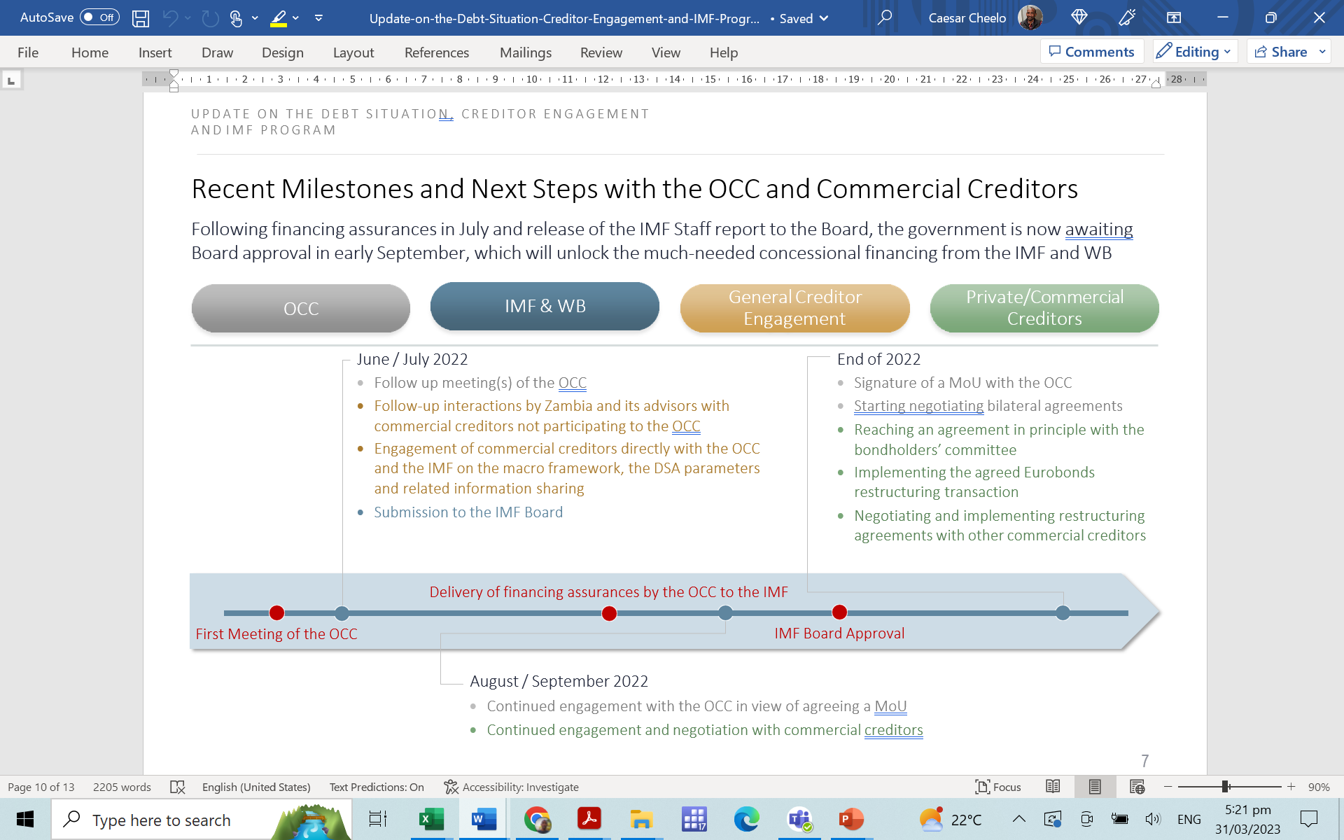
2. Debt Restructuring Negotiations
Broad timeline:
Initial talks with Eurobond holders…
G20 Common Framework in place…
IMF talks, with approval in Aug 2022…
Further talks under G20, with China coming on board
Full debt Restructuring deal was anticipated by end-March 2023…

Slide 8
2. Debt Restructuring Negotiations (cont’d)
Challenges to the negotiations:
Complicated debt structure…
G20 Common Framework may have WEAKNESSES/GAPS, incl. transparency of underpinning DSA…
New issues on the table, e.g., treatment of multilateral debt and local currency debt…
Global Geopolitical tensions…

Slide 9
2. Debt Restructuring Negotiations (cont’d)
Growing Macroeconomic instabilities:
Causing huge negative sentiment locally…
Social media…
Politicization…
Democratic pressure from campaign promises…
Corruption and fight against it causing various consequences, incl. Institutional inertia
But has been much worse before….

Slide 10
2. Debt Restructuring Negotiations (cont’d)
Zambia’s Other Socio-economic issues:
Employment (job earnings, quality, etc.) and Unemployment (esp. Female Youth Unemployment).
Poverty and inequality….
Rural-Urban divide; water resource management;
Education, health, energy, water and sanitation and the Demographic transition (an increasingly younger population).
Infrastructure gaps
Private sector productive capacity (to create jobs, invest, produce, export, etc.)
Public sector productive capacity (public institutional, policy and regulatory support)…
All these Creating immense pressure for bally to fix it!!!

Slide 11
2. Debt Restructuring Negotiations (cont’d)
MOFNP/BOZ team need to keep adjusting and moving:
  Must keep Regrouping as new information emerges;
  Must keep on with the pockets of negotiations, adjusting to creditor negotiation preferences (some creditors like transparency/publicity while others do not)….
  Must keep publishing information (e.g., frequent debt negotiation updates; treatment of domestic arrears, etc. all breathing confidence and counteracting negative sentiments)…
IN parallel, Public Sector reforms are necessary:
  Institutional reforms….
  Policy and regulatory reforms: focusing on jobs; PSD; fiscal management, incl. debt; social investments, etc.
No choice but to achieve Debt restructuring; so it will be done!!!

Slide 12
end

